Slide 1
Year 4 Residential Wednesday 15th – Friday 17th April
UWC Atlantic – St Donat’s Castle, Vale of Glamorgan

Slide 2
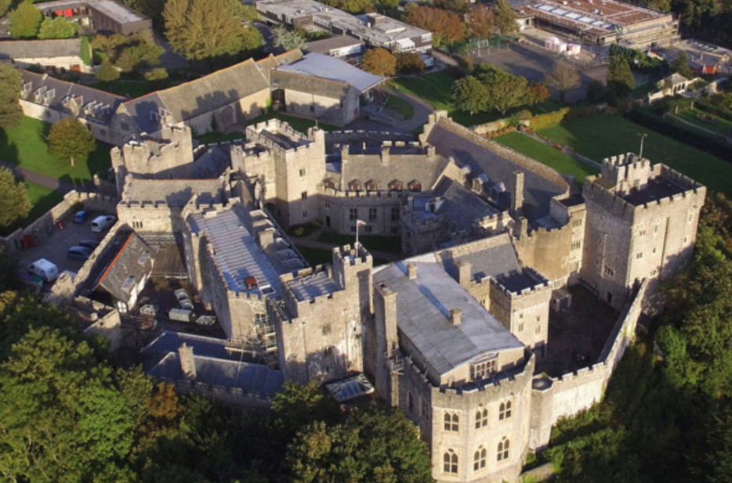

Slide 3
Introduction
Second year taking Radnor pupils
Range of activities for schools
Trained specialist coaches
Beautiful setting
Safe, supervised, and engaging experiences

Slide 4
Activities Offered
Archery & initiative games
Climbing tower & high ropes
Team games
Coastal walk
Cinema night
Woodland adventure (bushcraft)

Slide 5
2-Night Residential Package
3 activity choices over 3 days
Accommodation setup (48 beds, shared)
Teacher accommodation in same building
Activities subject to weather (alternatives provided)

Slide 6
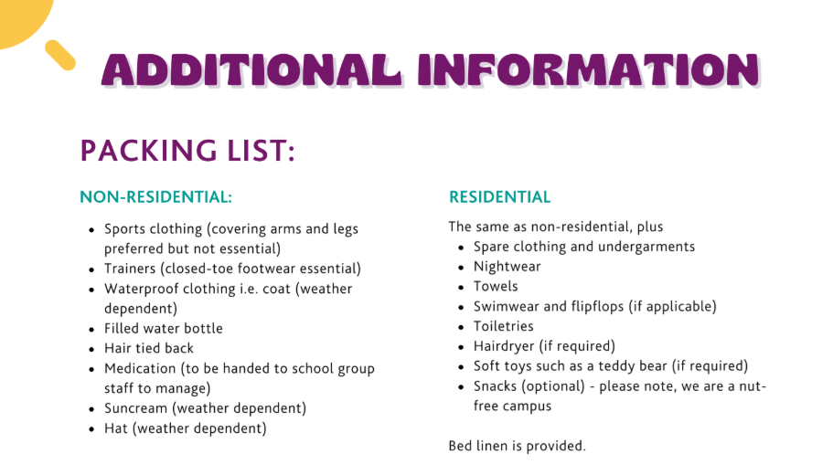

Slide 7


Slide 8
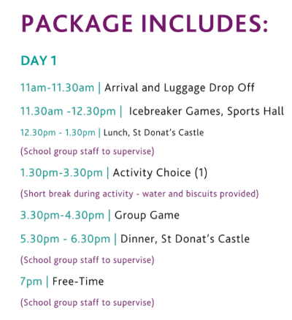

Slide 9


