Slide 1
Radnor Primary School
Safeguarding

Slide 2

What is safeguarding and promoting a child’s welfare?
Safeguarding is about keeping children safe from harm and abuse. This means keeping children safe from accidents, crime and bullying and actively promoting their wellbeing in a healthy, safe and supportive environment
…so as to enable them to have optimum life chances in adulthood

Slide 3
What is the relation between child protection and safeguarding?
Safeguarding means proactively seeking to involve the whole community in keeping children safe and promoting their welfare.
Child protection is the process of protecting individual children identified as either suffering, or at risk of suffering significant harm as a result of abuse or neglect.

Slide 4
Anti Bullying Policies
Child Protection
Staff Conduct
Attendance
Safeguarding
Curriculum
E-Safety
Managing
Allegations
Against Staff
Behaviour
Management
Health and Safety
Whistleblowing
Building Design
Safe
Recruitment and Selection

Slide 5
Duty to refer
If any person has knowledge, concerns or suspicions that a child is suffering, has suffered or is likely to be at risk of significant harm, it is their responsibility to ensure that the concerns are referred to Children’s Services or the Police who have statutory duties and powers to make enquiries and intervene when necessary
All Wales Child Protection Procedures 2008

Slide 6
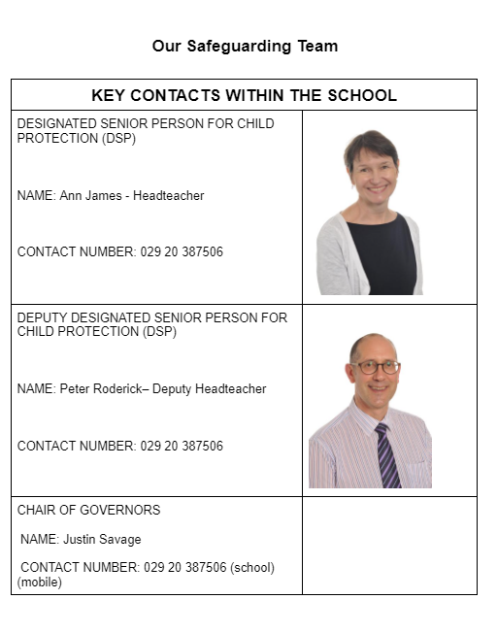
Key Contacts within the school

Slide 7

The protection of children is a multi agency responsibility.
You might hold a small
part of that jigsaw
Thank you

